Slide 1
DS-203 Project Group-49 190110002 Adithya Somaraj 200110076 Nithin Chandra gupta 19b080003 Akshat agarwal 20D100012 Kaushikraj

Slide 2
Outline
Grouping approaches
Shape Descriptors
Tight fitting box
Distance from centroid to vertices of layout
Complexity grouping
Retrieval of relevant layouts using tight fitting box approach

Slide 3

SHAPE DESCRIPTORS

Slide 4
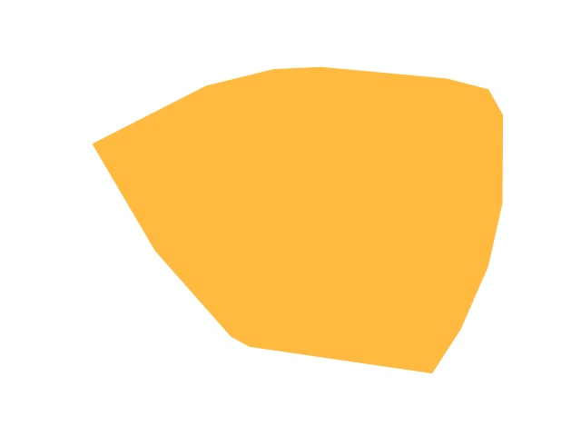
Features considered
The features extracted from a shape are following:
Number of edges
Perimeter
Area
Symmetry score
Convexity score
Convexity hull corners
Aspect ratio
Sample shape

Slide 5
Features ???
Perimeter : the perimeter of a shape is the total length of the boundary of the outer edge of the shape
Area : the area of a shape is the measure of the total space enclosed by the shape
Aspect ratio : aspect ratio of a shape is the ratio of its width to its height
Convex hull corners : convex hull of a shape is the smallest convex polygon that contains all the points or the shape. The vertices of the convex hull are called convex hull corners

Slide 6
How ARE these features important?
In shape descriptors approach, those features are extract which get the essence of the shape in terms of values.
Perimeter, area - these features provide information about the shape which can help to find similarity between different shapes
Aspect ratio - gives information about the shape's proportions and elongations which gives idea of its complexity
Symmetry Score - higher the symmetry score, lower the symmetry and higher the complexity of the shape

Slide 7
How ARE these features important?
Convexity Score : more complex shapes tend to have lower convexity scores.
Convexity-hull corners : more the number of corners, more the complexity of the shape
Edges : more the number of edges of the layout , more is the complexity of the shape

Slide 8
How did We proceed?
Input file : E7-images.zip
Platform used : Google colab
Steps Involved :
Step 1 : initially extracted the zip file and saved all the files in a directory
Step 2 : image is converted form BGR scale to HSV scale
Step 3: to get the contour of the yellow shape, a yellow mask made from yellow HSV ranges

Slide 9
How did we proceed?
Step 4 : edge detection is done using Canny edge filter and boundary (contour) of the yellow shape
Step 5 : image is converted form BGR scale to HSV scale
Step 6: to get the contour of the yellow shape, a yellow mask made from yellow HSV ranges
Step 7 : from the contour, convexity score, symmetry score, convexity hull scores are calculated using openCV library
Step 8 : Hu moments are used to find the symmetry score of the shape using the contour.
Step 9 : Hough lines are used to get the number of edges using the edges of the contour.

Slide 10
How Did we proceed?
Step 10 : a function is written which takes the image path as input and returns the calculated features as ouput
Step 11 : using the OS library and loops, features are stored in dataframe using the features_img function
Step 12 : a dataframe is made which has all the feature values with associated image
Step 13 : the perimeter and area values are normalized to get values in limit and use less memory
Step 14 : As we don't have labelled data, we used K-means clustering (unsupervised learning) to form cluster of data and 3 clusters are choosen which are low, medium and high complexity.

Slide 11
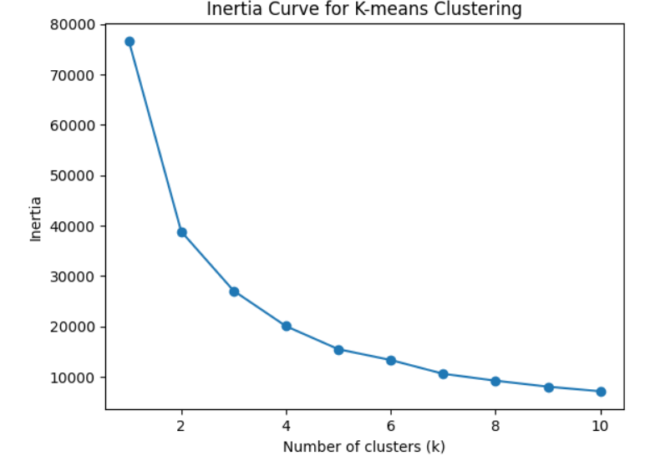
K-Means clustering curve
The above graph tells me the optimized no. of clusters needed using the above generated features

Slide 12
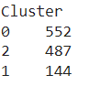
How Did I proceed?
Step 15 : the 3 cluster method of grouping images into got a decent similairty segregation between shapes
Step 16 : based on the above features, the images are grouped into 3 clusters of different complexity.

Slide 13
Challenges with shape descriptors approach
Initially to get the boundary line, directly using the inbuilt openCV function is giving the outer boundary line of the white background.
Even turning image into gray scale didn't help to get the correct contours
Getting complexity sensing independent features is hard, if not present, we have to do transforms to get those features

Slide 14
TIGHT-FITTING BOUNDARY BOX

Slide 15
Features considered
The features extracted from a shape are following:
Length of tight-fit box
Breadth of tight-fit box
Area of tight-fit box
Area of the shape/figure
Aspect-ratio of box
Bounding box ratio

Slide 16
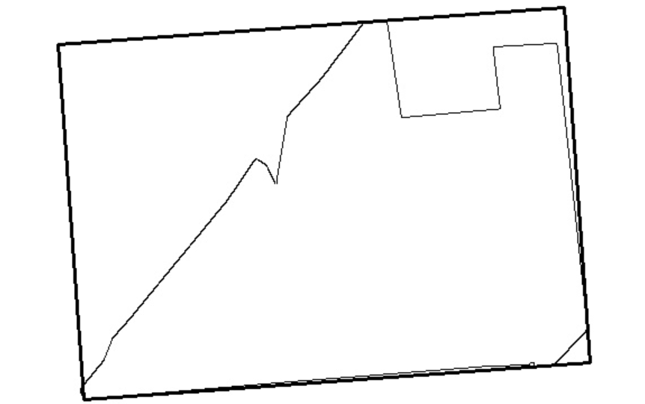

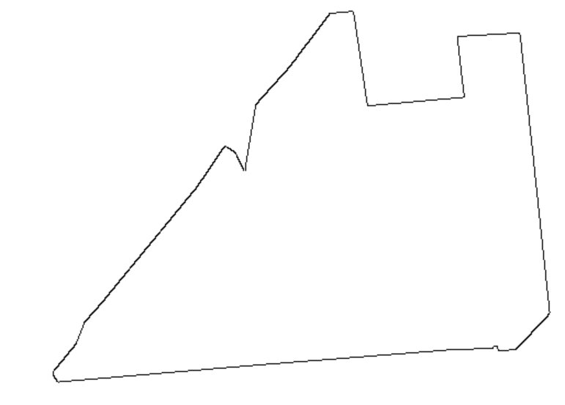
Sample Image with Boundary Points and centroid:-
Sample shape
Sample shape converted into grayscale
Tight-Fit Box

Slide 17
Features explained
Length, breadth : These are the two dimensions of the tight-fit box which is a rectangle.
Area : The areas of both, the shape and the tight fit box are considered. This is calculated as the no. Of pixels present in the shape and inside the box.
Aspect ratio of box : Aspect ratio of the box is taken as the ratio of its breadth to its length. This is done to ensure it is less than 1.
Bounding box ratio: This is the ratio of the area enclosed by the shape to the area enclosed by the tight-fit box. This is also done to ensure its value as less than 1.

Slide 18
How ARE these features important?
In the Boundary box approach, the features we extract are obtained uniquely by this method
Length, breadth, area of rectangle - These features provide the minimum area of plot required by the customer for his building
Aspect ratio - This gives the idea of whether the plot has equal sides or is very elongated in one direction with limited length in other directions
Bounding box ratio - This gives the amount of area occupied by the building within a certain rectangular plot

Slide 19
METHODOLOGY
Input file : E7-images.zip
Steps Involved :
Step 1 : Zip file is uploaded and extracted into a given directory
Step 2 : Each image has its boundary extracted and we give a gray color to each pixel in the boundary
Step 3: After that, we produce a tight-fit box, with color black, to each of these images which contain only the boundary

Slide 20
METHODOLOGY
Step 4 : Edge detection is done using openCV library
Step 5 : Input image of boundary is read
Step 6: Thresholding is applied to the grayscale image to isolate the white regions. Pixels with intensity values greater than threshold are set white and others as 0
Step 7 : Contours are found and approximated with a polygon with a fixed approximation accuracy
Step 8 : The convex hull and minimum rectangle area is found
Step 9 : We extract length, breadth and area of the tight-fit rectangle as features for our analysis

Slide 21
METHODOLOGY
Step 10 : We save 3 copies of each image, 1 as the original, 1 as the boundary grayscale and 1 with the bounded box
Step 11 : We calculate other features like area of rectangle, aspect ratio, bounded box ratio
Step 12 : We combine each feature into a separate array for each datapoint and standardize it
Step 13 : We apply k-means classification and cluster the data into 3 different groups. This will give us the clustering based on complexity
Step 14 : We calculate complexity scores of each individual data-point to identify it's own specific complexity relative to the other datapoints.

Slide 22
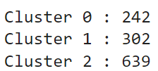
METHODOLOGY
Step 15 : The 3 cluster k-means method of classification produced a segregation of the 1183 datapoints into 3 separate complexities. Below is the distribution of all the data-points
Cluster 0 refers to low complexity, Cluster 1 refers to medium complexity and Cluster 2 refers to high complexity
Step 16 : We then calculate the relevant graphs required to visualize the present data and its important features

Slide 23
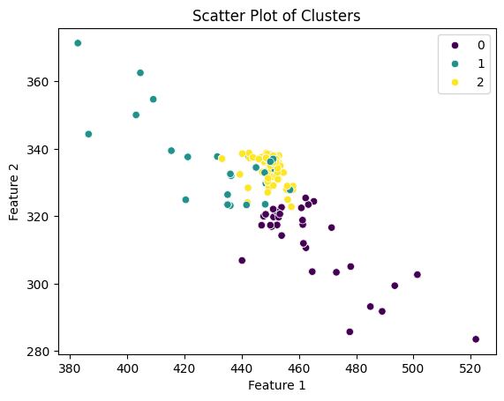
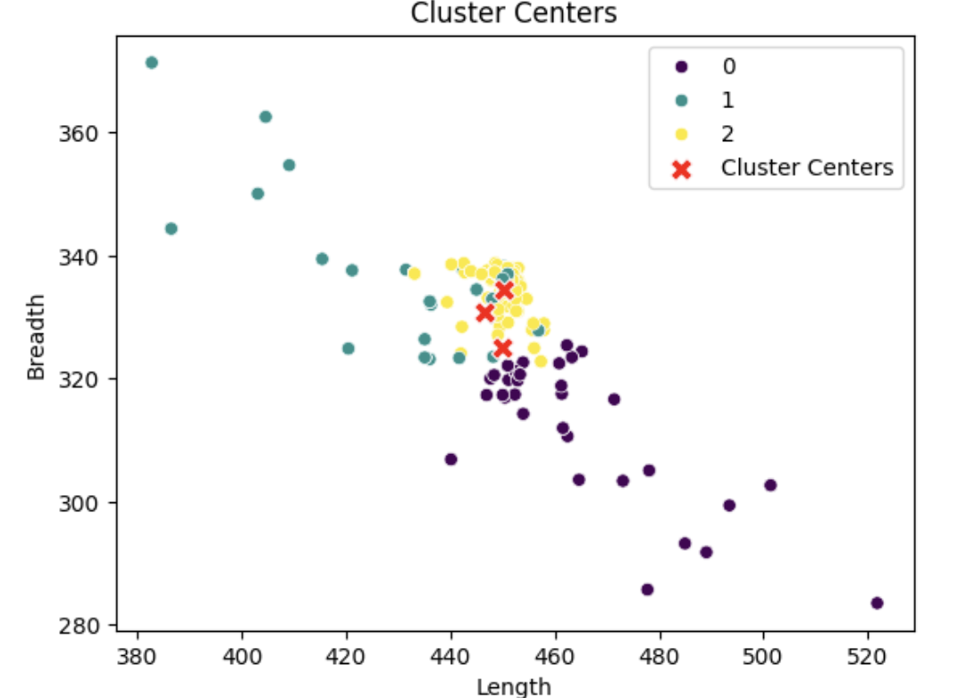
K-Means clustering Scatterplot of length vs breadth

Slide 24
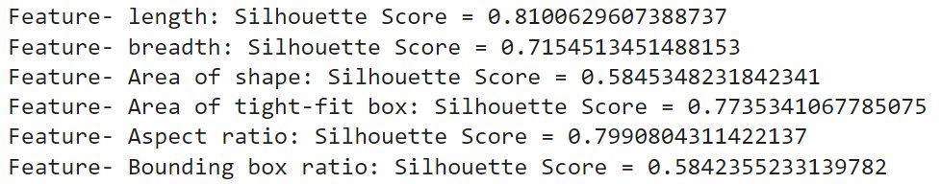
Significance of features
Features with higher silhouette scores are more significant in separating the data into distinct clusters.
This indicates that length is the most important factor in clustering the data into 3 complexities.
Aspect ratio is also considered as an important feature due to its correlation with length.

Slide 25
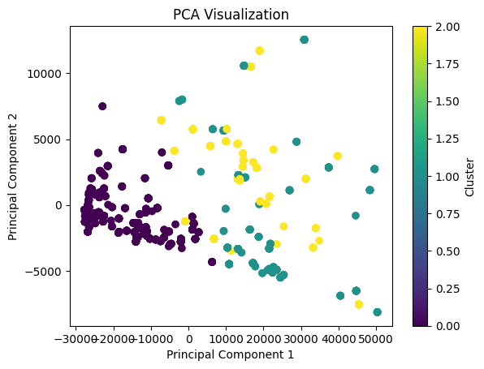
pcA visualization

Slide 26
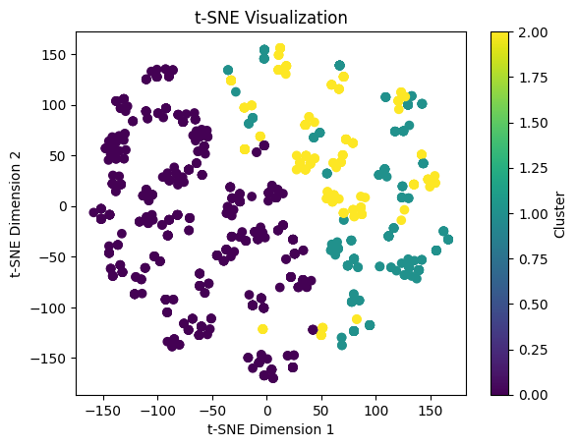
t-sne visualization

Slide 27
Challenges with TIGHT-FIT BOX approach
Some images, around 40 were giving more area for the shape than the box. This could have been better coded to ensure the complete enclosure of the shape inside the boundary box.
We still lacked the visualization and interpretation of the images into 3 clusters based on complexity due to the nature of the data and it being present as images.
The computational time was well over 20 minutes to create a bounded box for all images. This makes it a more time-consuming process if we start from scratch every time.

Slide 28
Distance from Centroid to The Boundary Points of Layout

Slide 29
How did We proceed?
Input file : E7-images.zip
Platform used : Google colab
Steps Involved :
Step 1 : initially extracted the zip file and saved all the files in a directory
Step 2 : image is converted form BGR scale to grayscale and gaussian blur is applied to reduce noise.
Step 3: Canny edge detection is applied to find edges and contours are detected on this edge-detected image.

Slide 30
How did We proceed?
Step 4 : Then Contours are drawn on the original image using the matplotlib methods
Step 5 : Boundary points are calculated and plotted on the grayscale image.
Step 6: Then , centroid is calculated for the given shape
Step 7 : Then the calculated centroid is plotted on the original image
Step 8 : Distances are calculated from the centroid to the boundary points.
Step 9 : Then, a frequency histogram (distribution) is plotted from the calculated distances from the centroid to the boundary points.

Slide 31
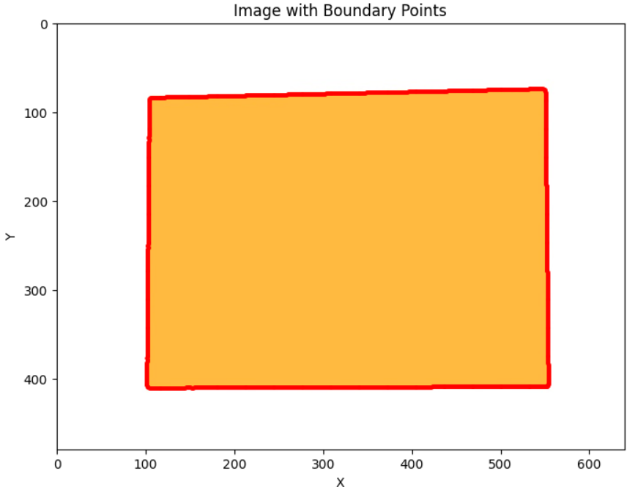
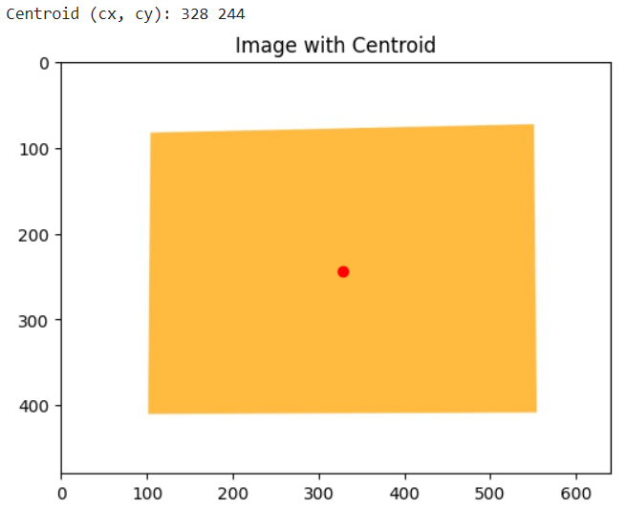
Sample Image with Boundary Points and centroid:-

Slide 32
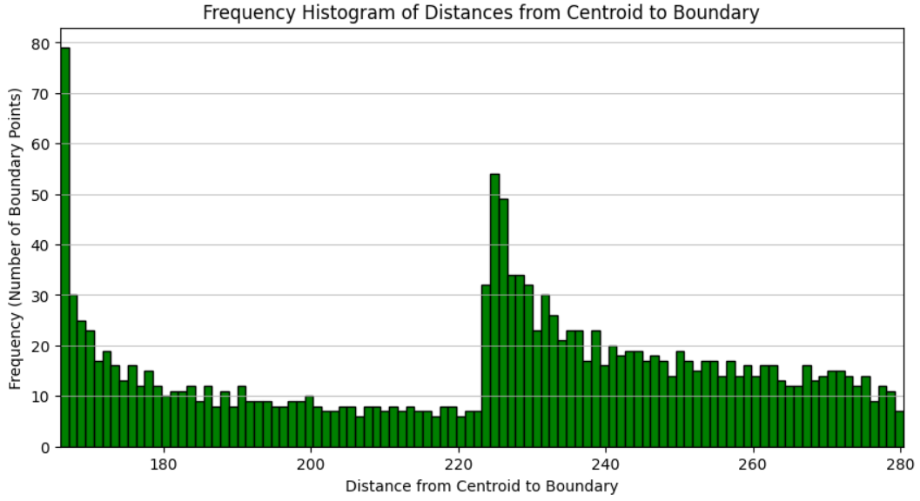
Sample Histogram of the Image given in the previous slide
Histogram is made on distances drawn from the centroid found to the boundary points.
Later, Hellinger Distance is used to find similarity of histogram of images taken any two at a time.

Slide 33
But why choosing Hellinger distances and how are they calculated?
How did We proceed?
Step 10 : Then, some of the similarity metrics are used to calculate the similarities between the distributions found to club those images together.
Step 11 : The distances found from the centroid to the boundary points are standardized before passing them into Hellinger Distance Function. So, they can be easily compared.
Step 12 : Hellinger distances are used to calculate the similarity numbers.
The Hellinger Distance is a measure of the similarity between two probability distributions. It is based on the concept of the Hellinger Kernel, which quantifies the difference between the square root histograms of the distributions.

Slide 34
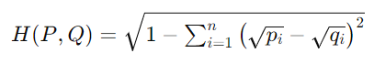
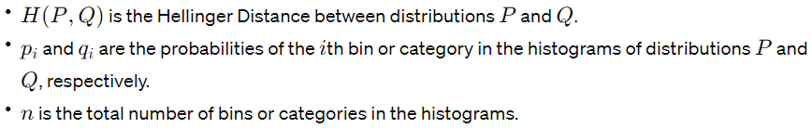
Here:-
The Hellinger Distance ranges from 0 to 1, where:
0 indicates that the two distributions are identical.
1 indicates that the two distributions are completely different.
How we do our analysis:-
In our analysis, we took a cutoff of <= 0.1 to categorise the images which are similar to each other to group them with each other. Hellinger distances with values greater than 0.1 are rejected.

Slide 35
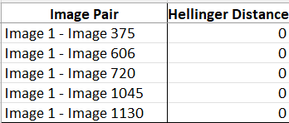
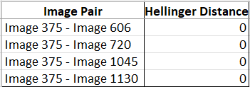
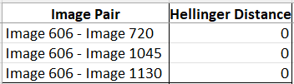
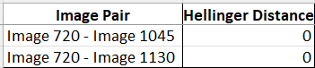
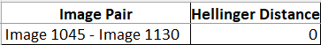
Challenged Faced:-
With this method, we can only compare two images at a time, and then we have to group all images which are mutual similar which is a lengthy process but gives out very robust groups. Like I will show next in results.
Taking an example, in Table 1 given below, we have following groupings:- Image 1 is similar to Images 375, 606, 720, 1045, 1130 and then in Table 2, Image 375 is similar to Image 606, 720, 1045, 1130 which (only) contains the images that are in Table 1. Similarly, Image 606 in Table 3 is similar to Images 720, 1045, 1130. Same for Table 4 and Table 5. Hence, Images 1, 375, 606, 720, 1045, 1130 will make a group.
Results:-
Table 3
Table 2
Table 1
Table 4
Table 5

Slide 36
Links to code and files:-
Shape Descriptors
Link to the Code_Of_Shape_Descriptors
Tight Fitting Bounded Box
Link to the code
Grouping using Hellinger Distance (Using Centroid Method)
Link to Groupings_In_Excel
Link to code used to generate Centroid and Hellinger Results
Kindly note that all these files are also attached in the submission.

Slide 37
Thank you
Group 49

